Slide 1


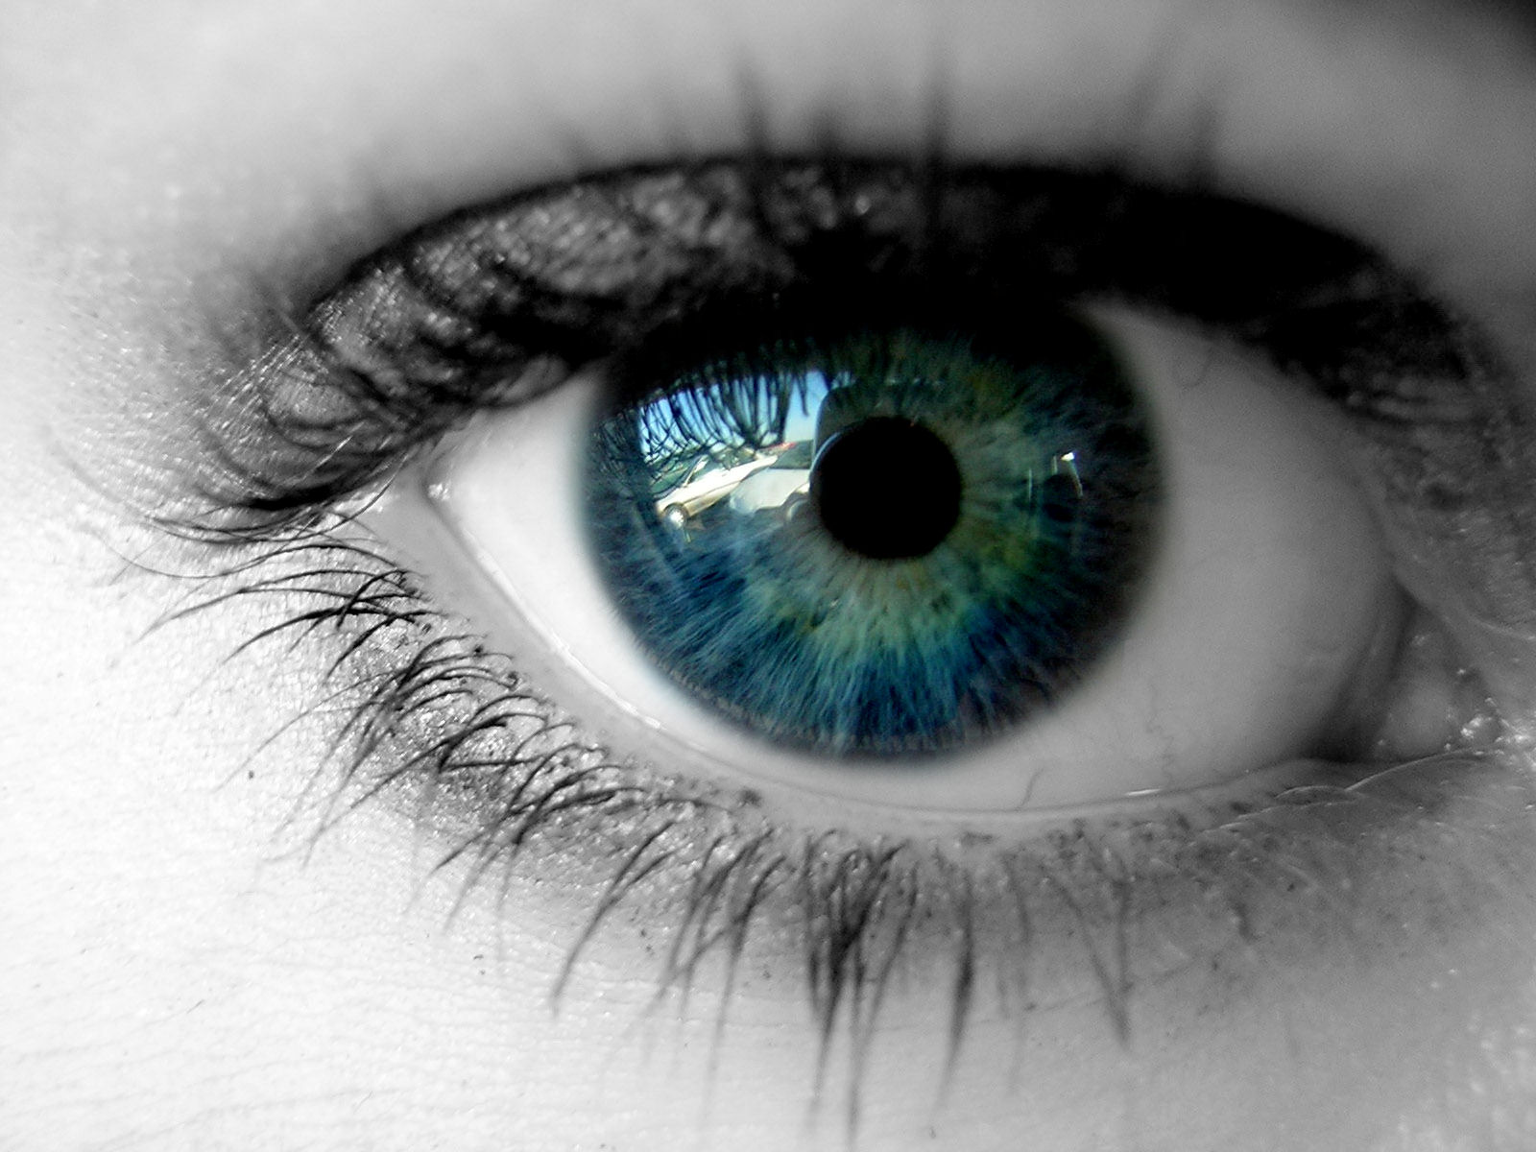



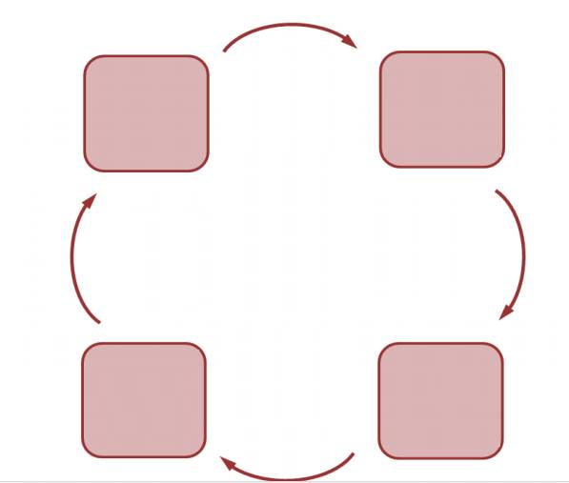
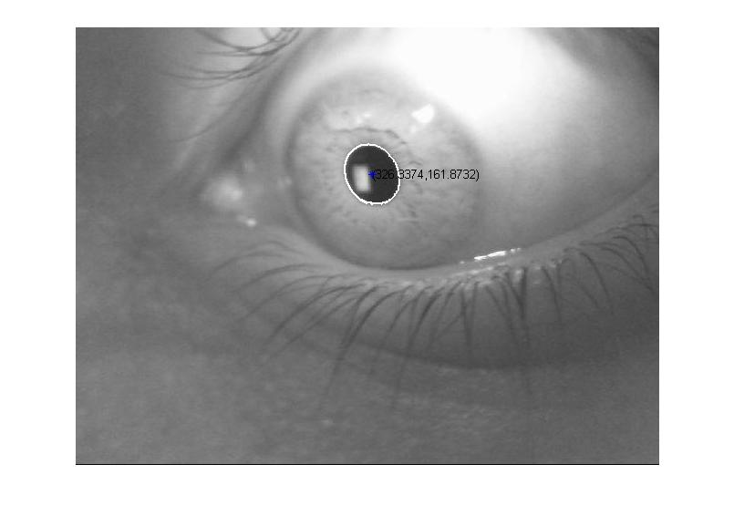
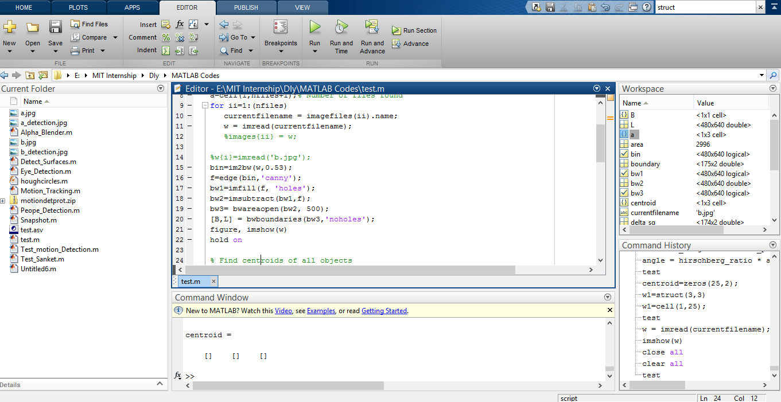

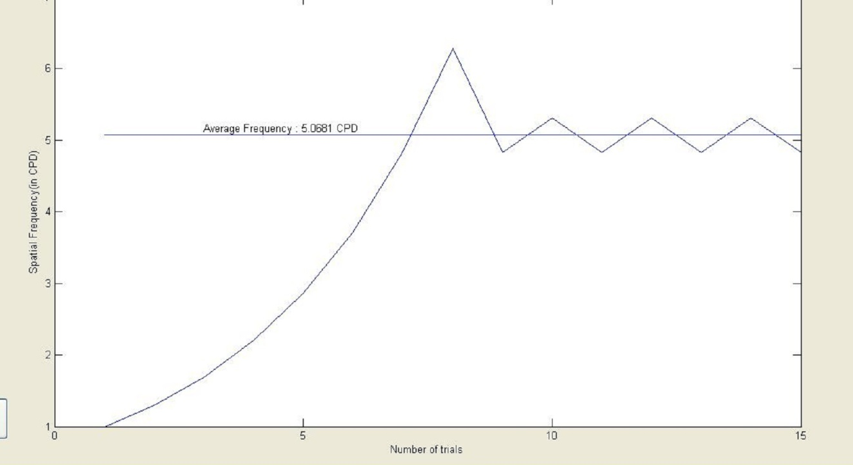
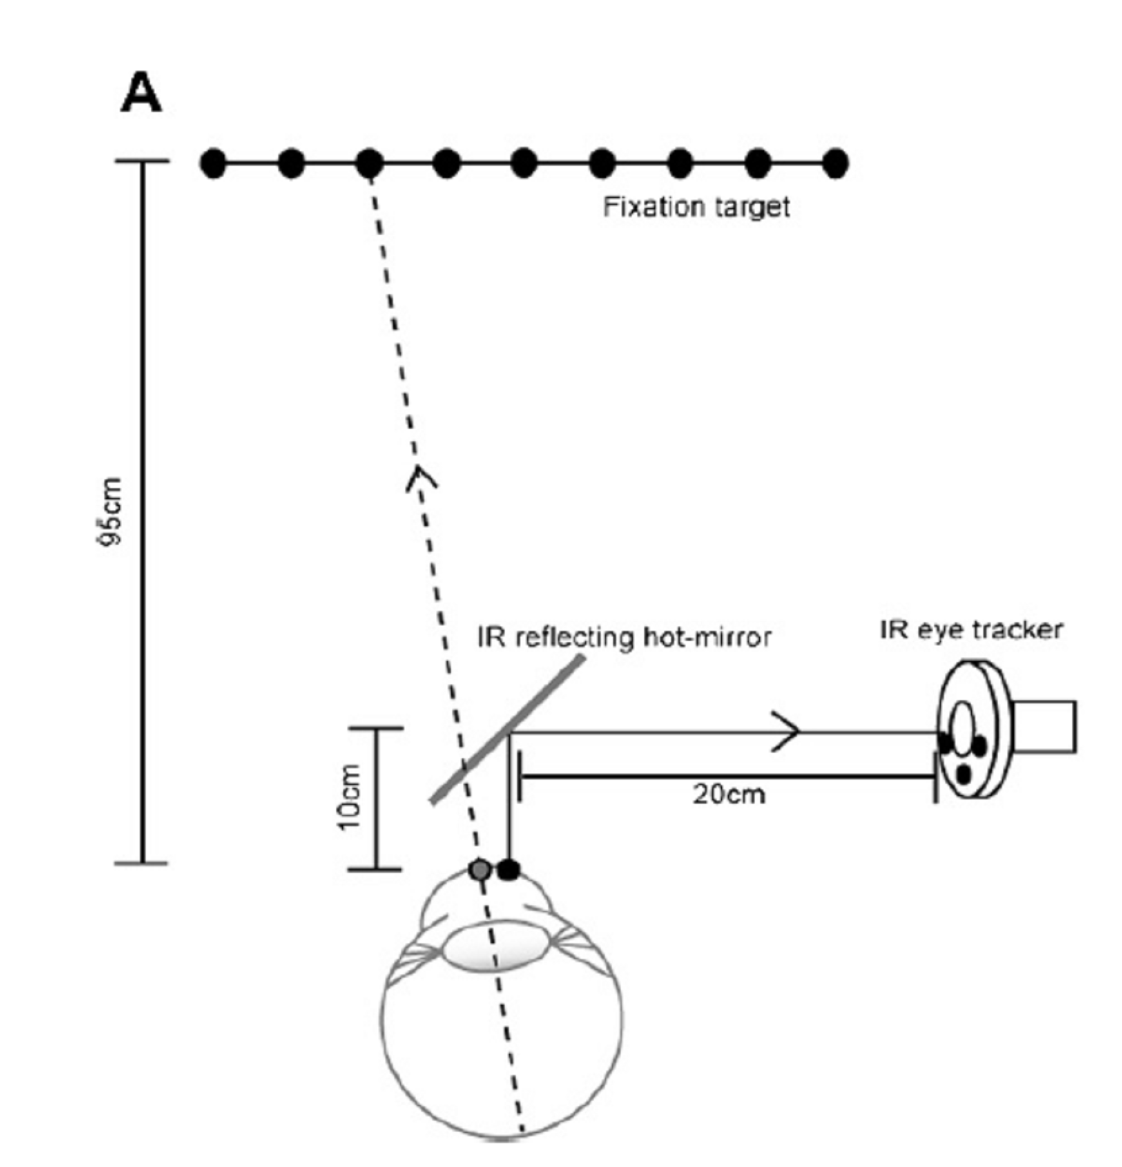
Gaze Tracker
Team: Deepak, Saboor, Sanket, Khyathi, Sabareesh, Harini
Mentors: Amy Lawson, Shrikant Bharadwaj
LVP-MITRA Innovation Center
Problem Statement
Clinical Motivation
Development of a low-cost gaze tracking system that is based on a webcam mounted close to the user’s eye, for robustly tracking gaze to be easily integrated into other diagnostic tools.
As early diagnosis and treatment efforts soar, so does the need to identify novel characteristics that may indicate a toddler’s risk for manifesting eye defects. Gaze tracking technology holds promise as an objective methodology for characterizing the early features of eye defects because it can be implemented with virtually any age or functioning level. Its tremendous potential also includes pediatric perimetry, super stereo, automation etc.
Approach
Gaze Tracking
Analysis
Close range hi-res IR image capture for analysis
Pupil center detection and Purkinje image detection
Hirschberg ratio comparison for gaze direction vector calculation
Gabor grating Stimulus to attract attention of viewer
No calibration required - for easier use with infants
Real time tracking for faster results
Result
Limitations
It requires a close range image
Only one eye can be monitored at a time
Lack of calibration step leads to reduced precision in tracking
Stimulus
Future Scope
High precision tracking, with real time optimization
Integration with super stereo, pediatric optometry
Simultaneous analysis of both eyes

